Slide 1

WIPRO NGA Program – Data Center Batch 9
Capstone Project Presentation –12th and 13th Aug
Project Title Here – Library Management System
Presented by – Aryan Panwar (user id – 31287)
www.rpsconsulting.in

Slide 2

Project Overview
Complete digital transformation of traditional library operations
Full-stack web application with microservices architecture
End-to-end automation from development to deployment
Cloud-native approach using containerization and orchestration
2025 - RPS Consulting all rights reserved

Slide 3
Technical Architecture
Frontend Layer
Angular 17 with TypeScript
Material Design UI components
Responsive web interface
Real-time data synchronization
Backend Layer
Spring Boot 3.1.5 with Java 17
RESTful API architecture
Spring Security for authentication
JPA/Hibernate for data persistence
Database Layer
MySQL 8.0 database
Relational data modeling
Automated migrations
Sample data initialization
2025 - RPS Consulting all rights reserved

Slide 4
Core Functionality
Book Management
Complete CRUD operations for book inventory
ISBN validation and duplicate prevention
Genre-based categorization
Availability tracking with copy management
User Management
Member registration and profile management
Multiple membership tiers (Regular, Premium, Student)
User status tracking and permissions
Contact information management
Borrowing System
Automated book checkout and return
Due date calculations with membership-based periods
Overdue tracking and fine calculation
Borrowing history and analytics
Admin Portal
Secure authentication system
Role-based access control
Dashboard with real-time statistics
System monitoring and health checks
2025 - RPS Consulting all rights reserved

Slide 5
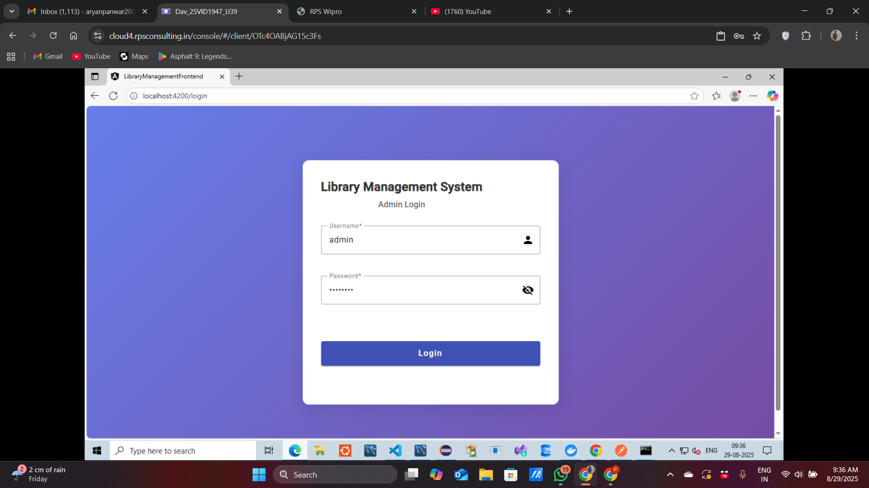
Admin Page
2025 - RPS Consulting all rights reserved

Slide 6
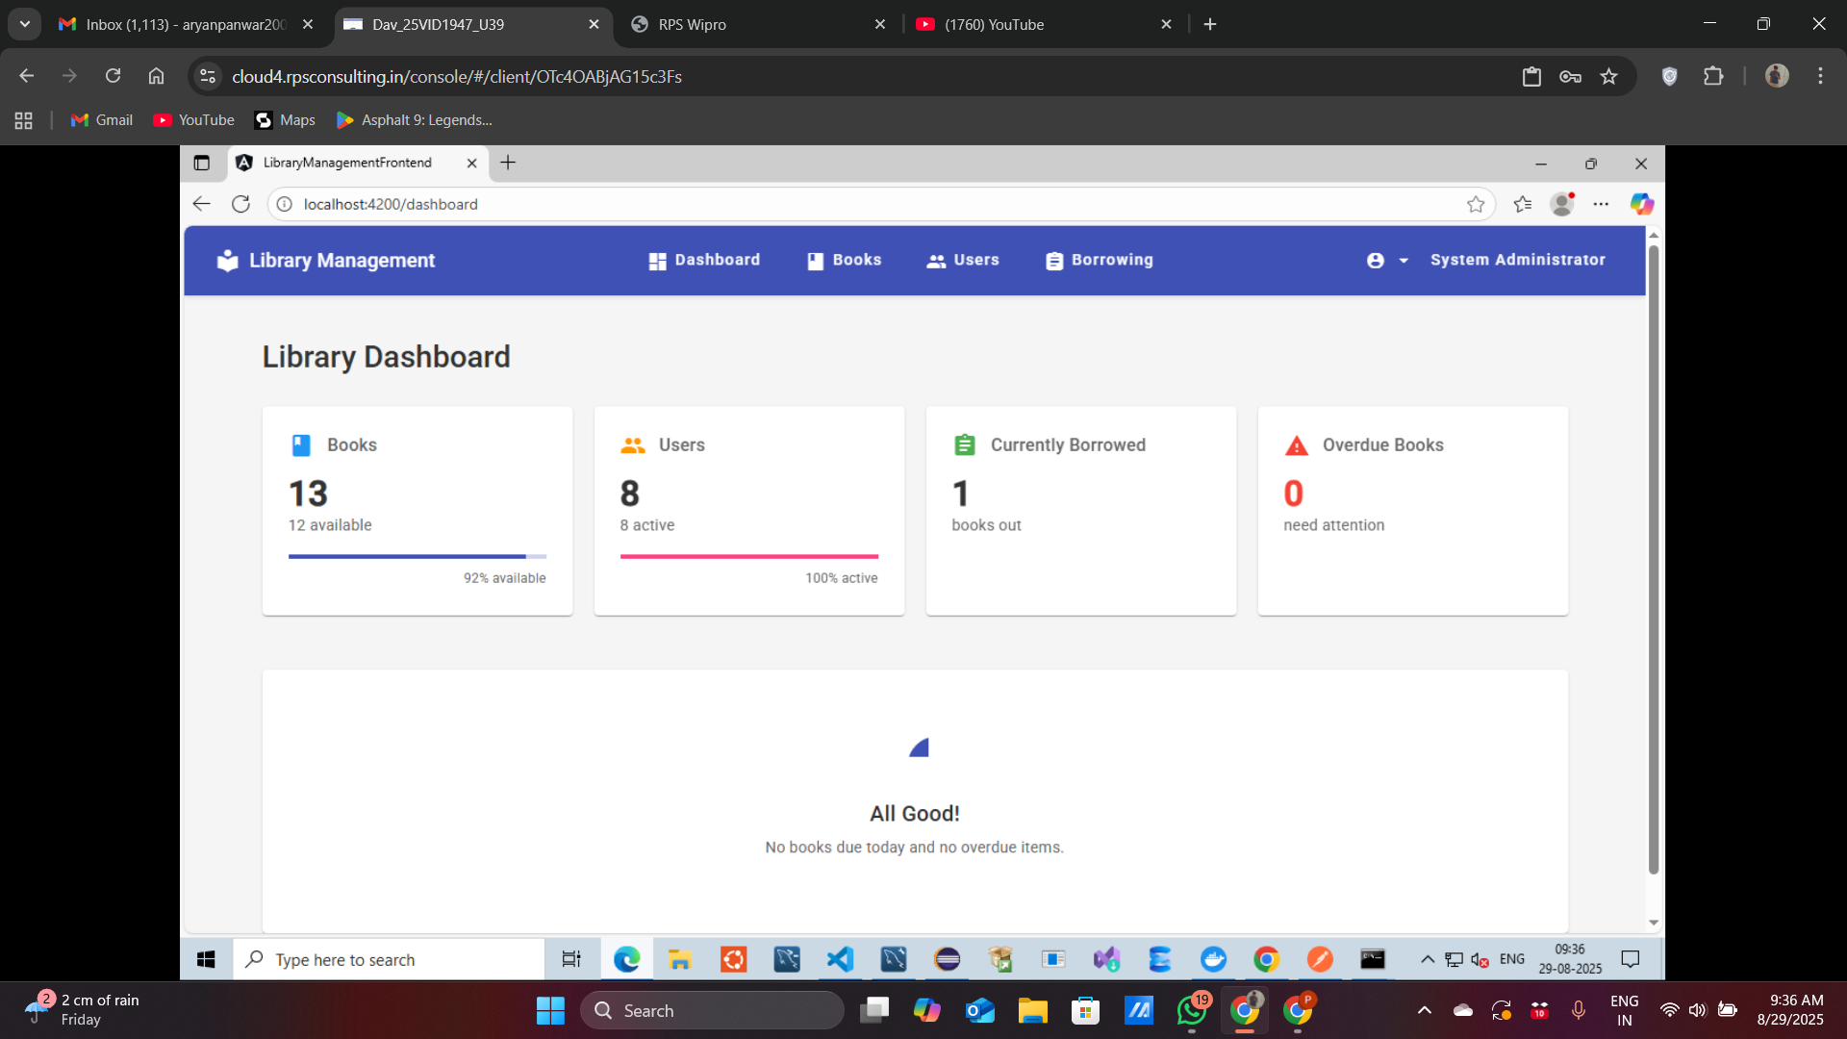
Dashboard Page
2025 - RPS Consulting all rights reserved

Slide 7
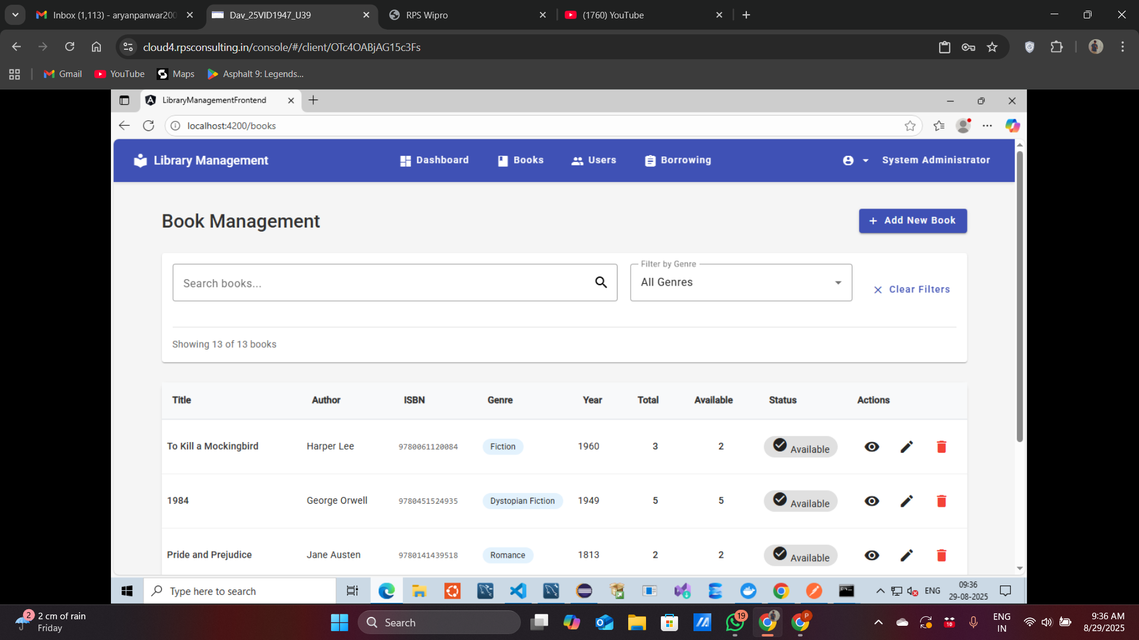
Books Page
2025 - RPS Consulting all rights reserved

Slide 8
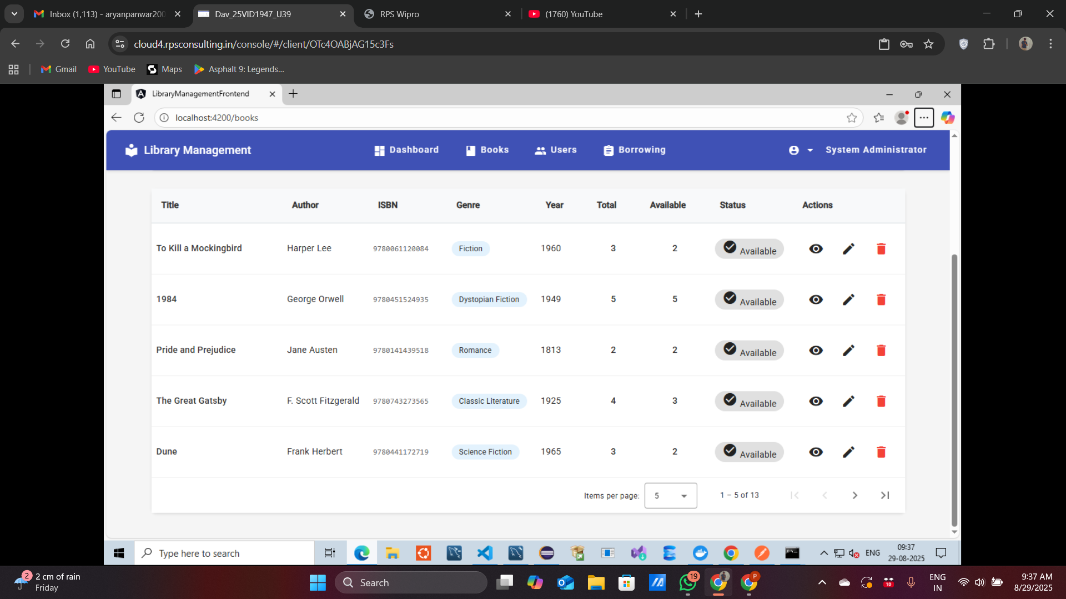
Books-List
2025 - RPS Consulting all rights reserved

Slide 9
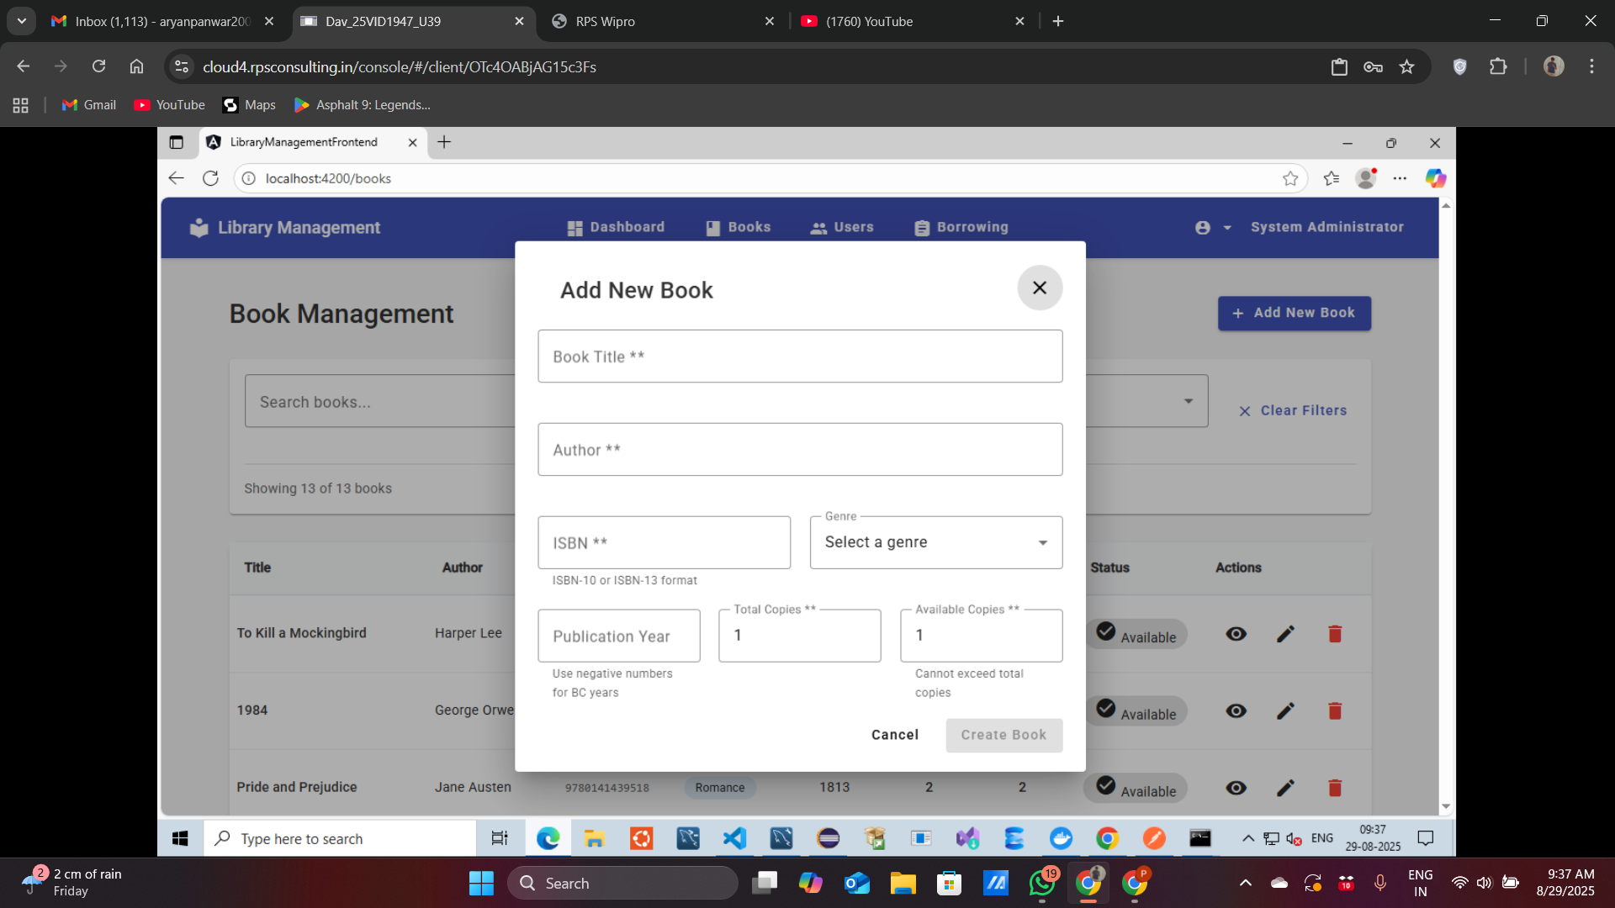
Add Book
2025 - RPS Consulting all rights reserved

Slide 10
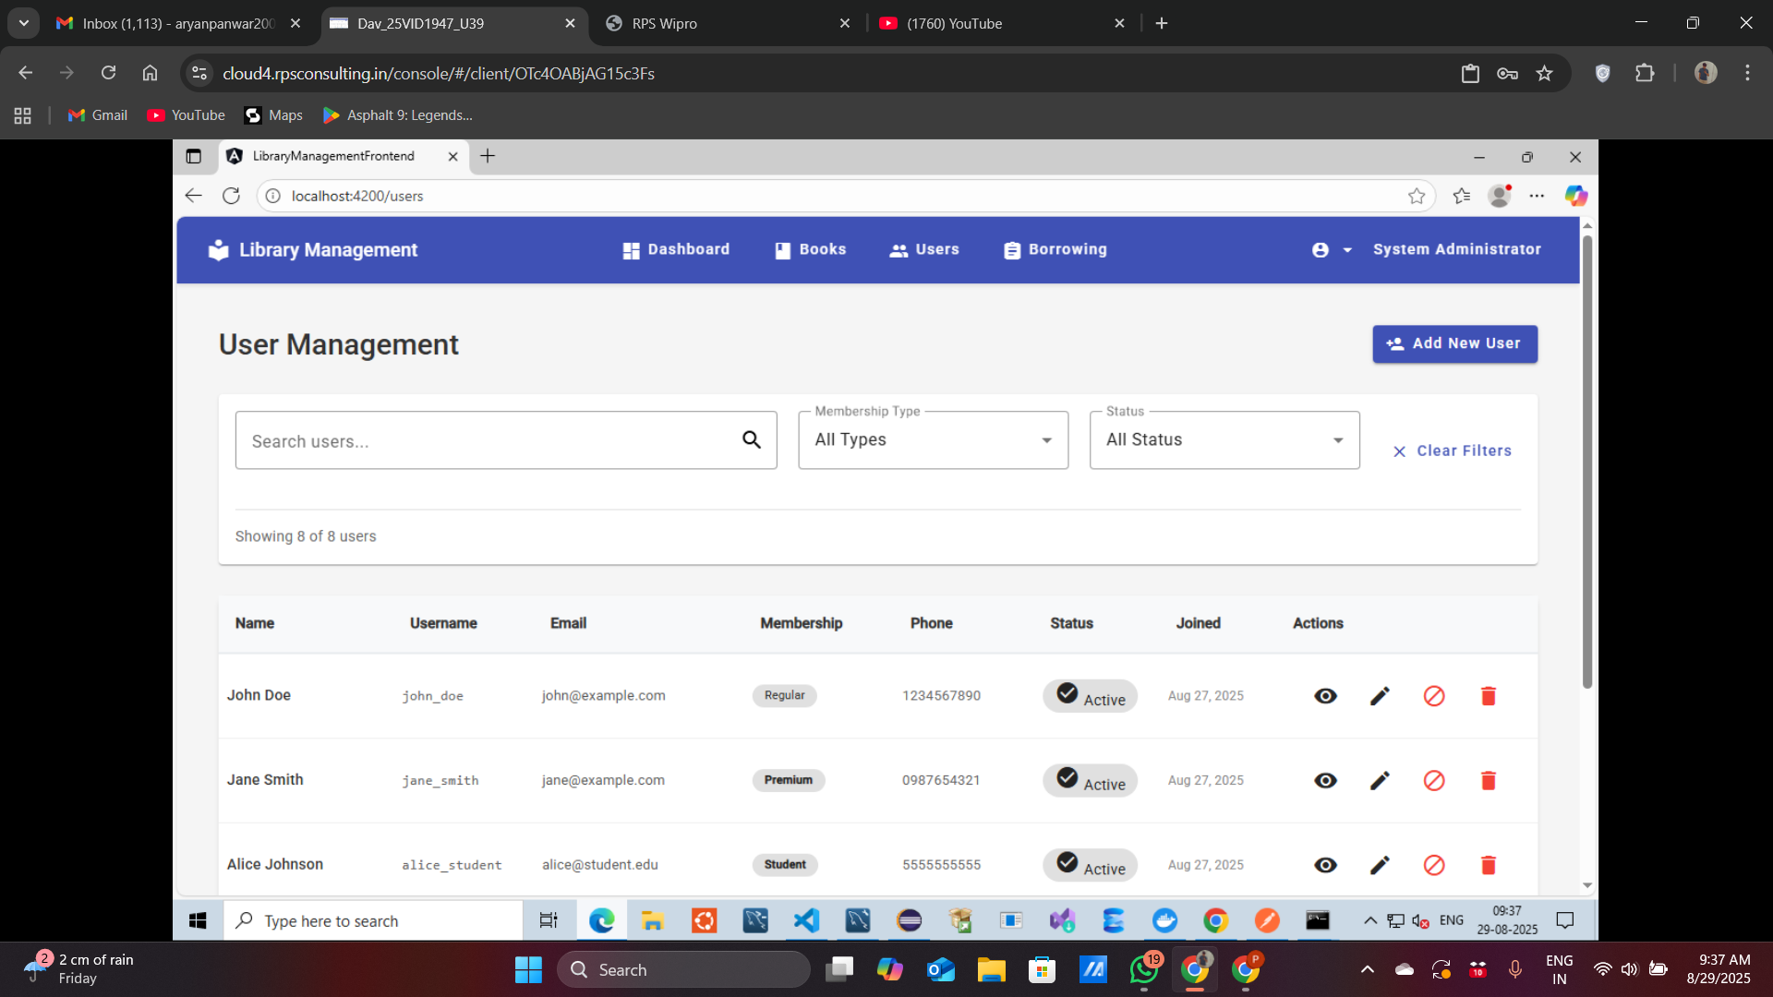
Users Page
2025 - RPS Consulting all rights reserved

Slide 11
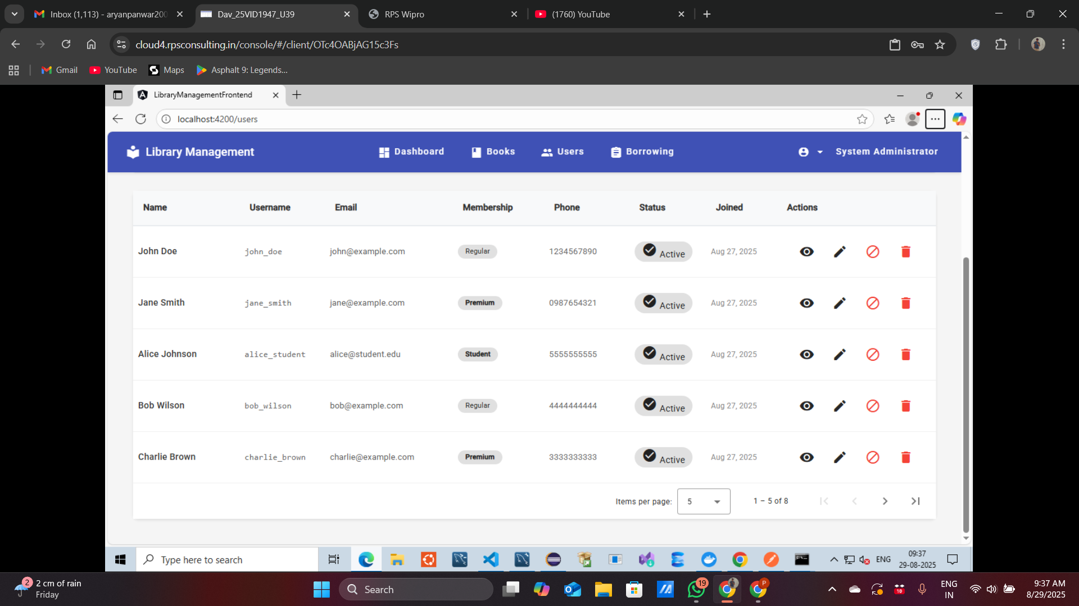
User-List
2025 - RPS Consulting all rights reserved

Slide 12
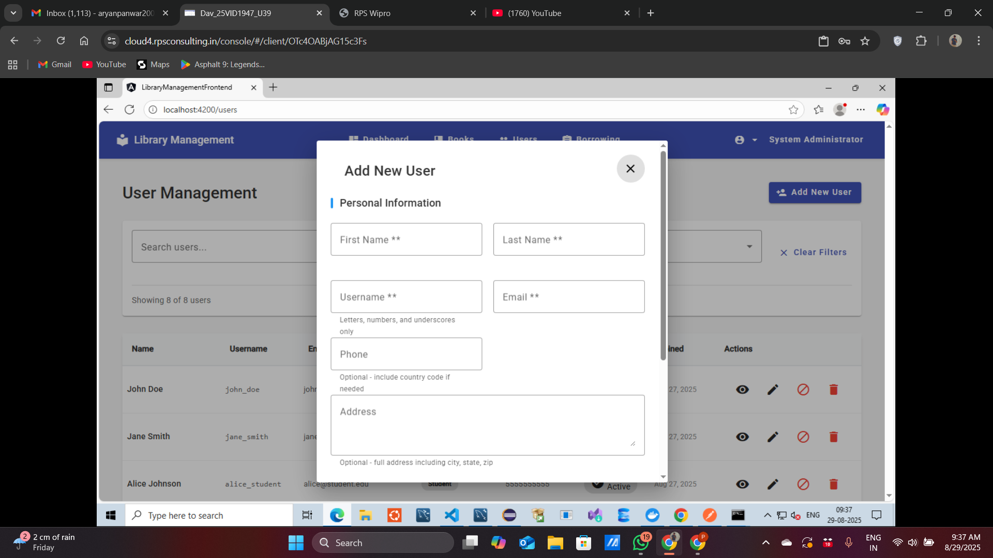
Add User
2025 - RPS Consulting all rights reserved

Slide 13
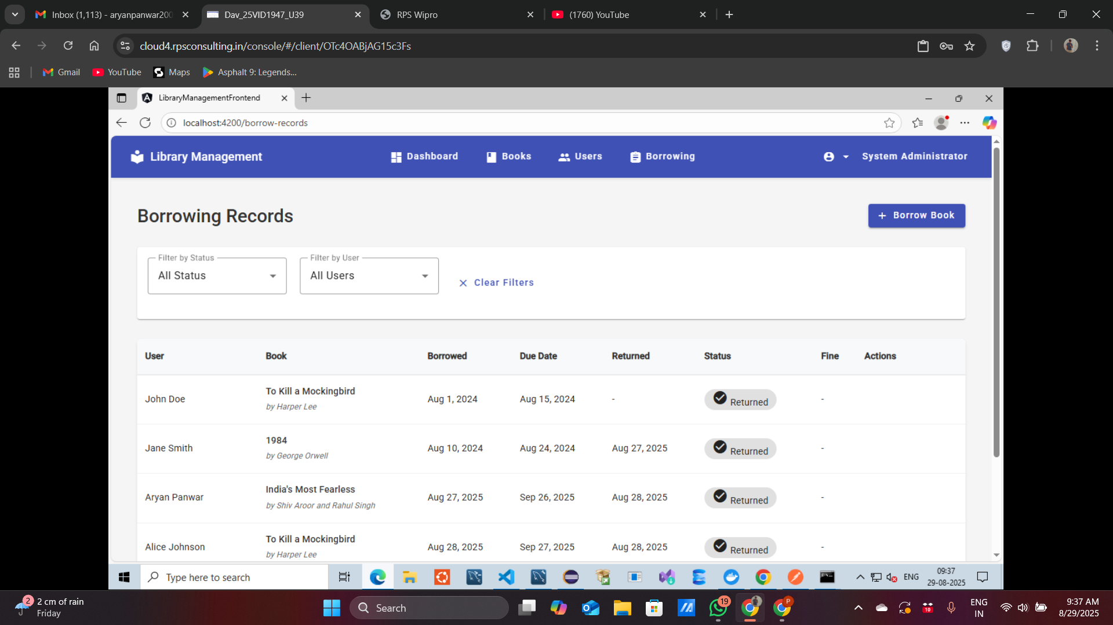
Borrow Records Page
2025 - RPS Consulting all rights reserved

Slide 14
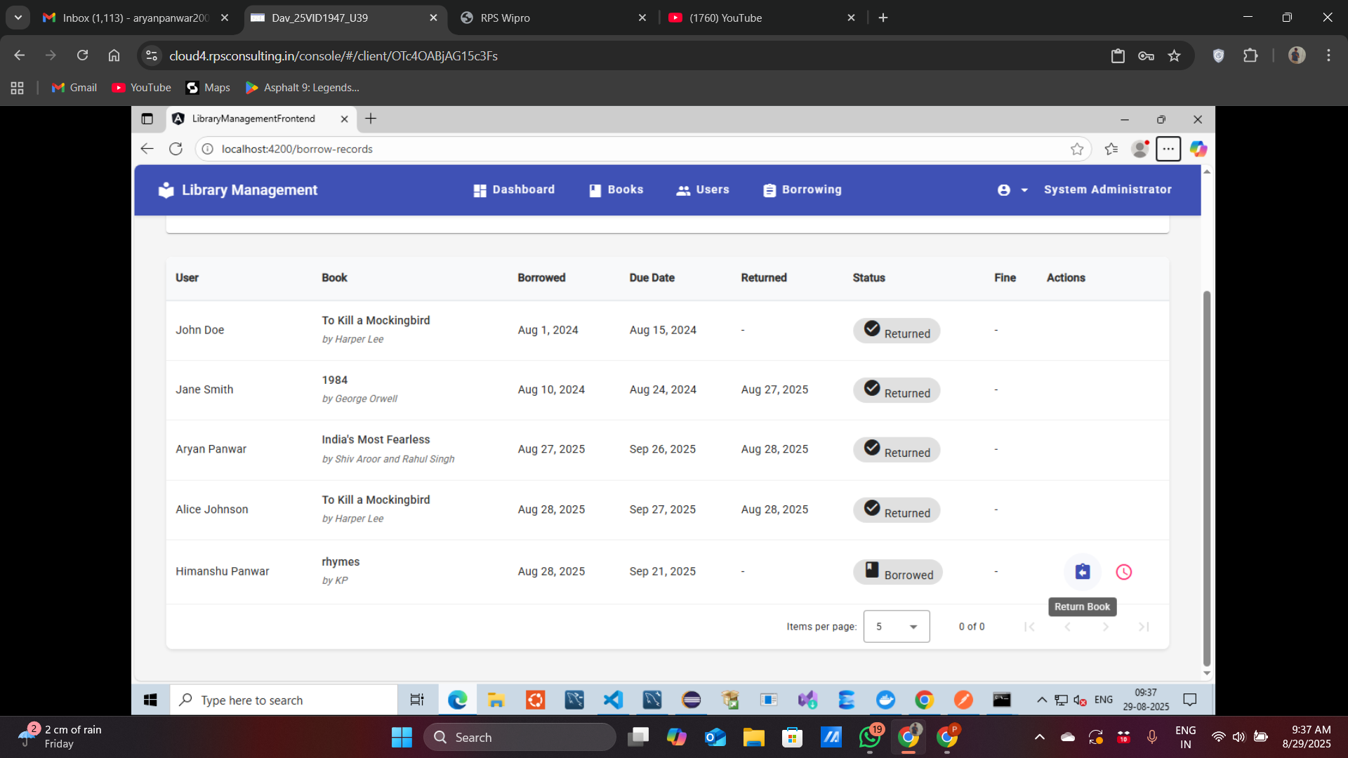
Borrow-List
2025 - RPS Consulting all rights reserved

Slide 15
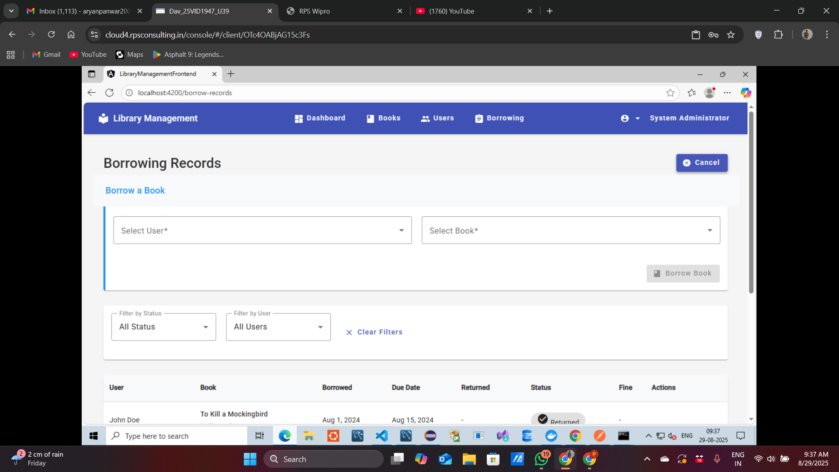
Borrow Book
2025 - RPS Consulting all rights reserved

Slide 16
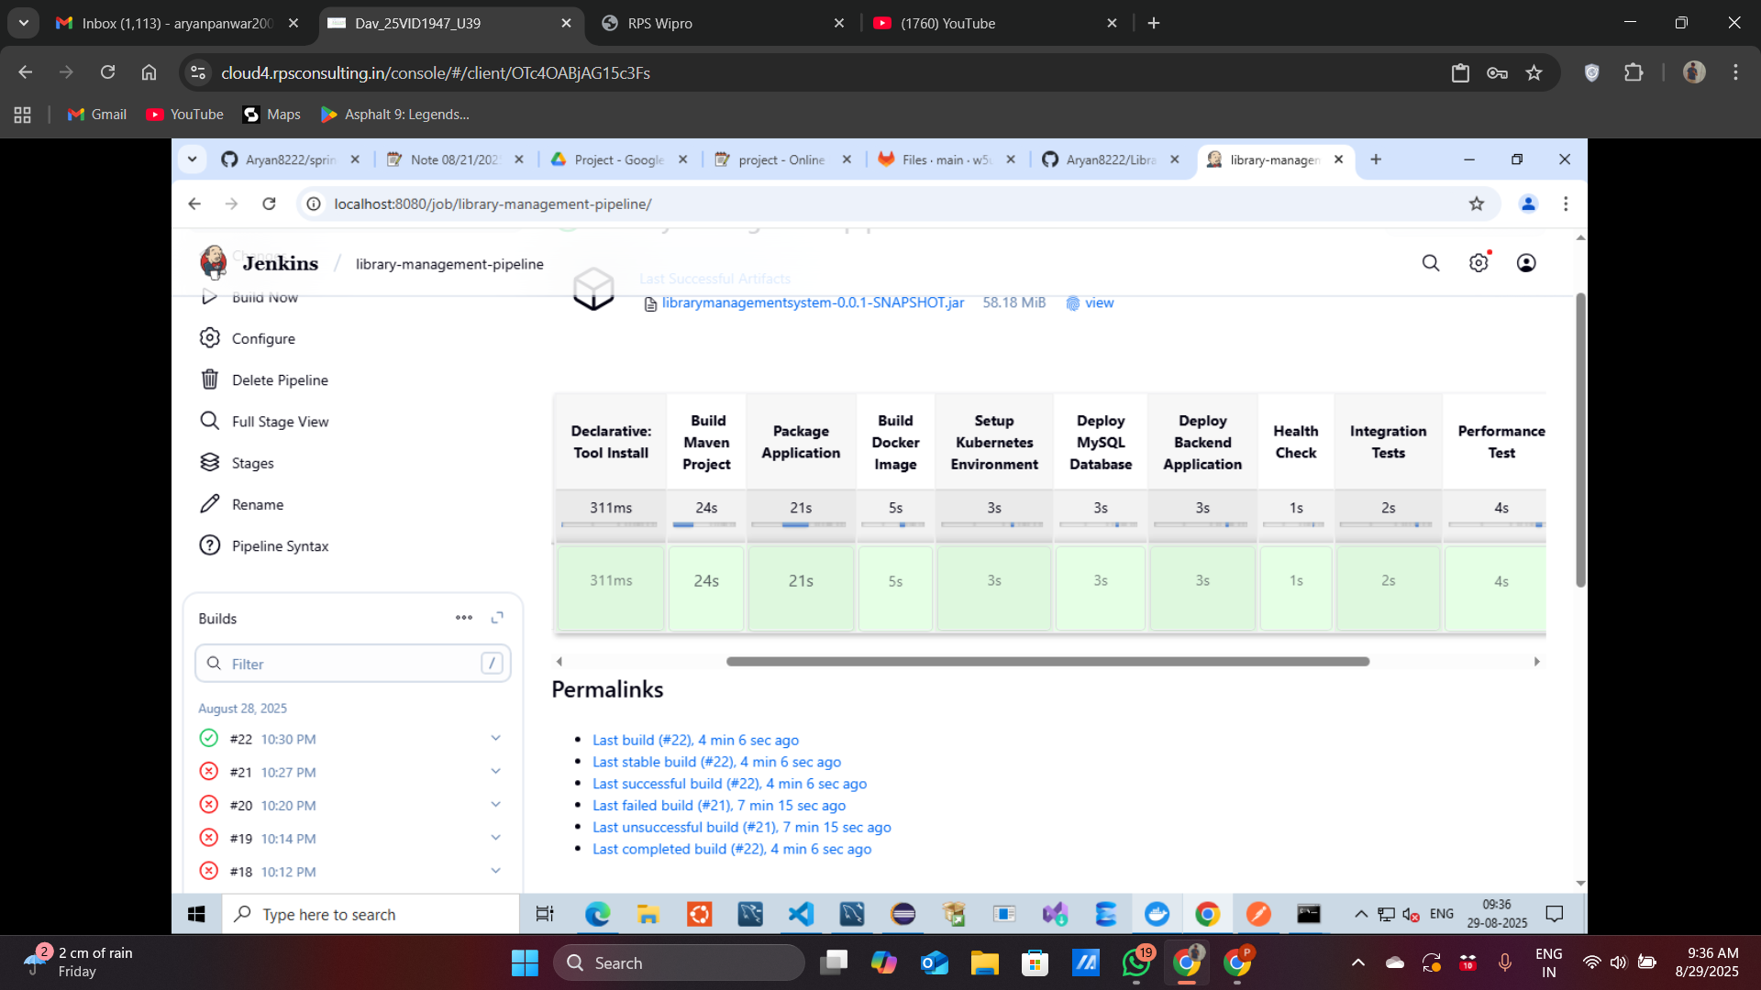
Jenkins Deployment
2025 - RPS Consulting all rights reserved

Slide 17
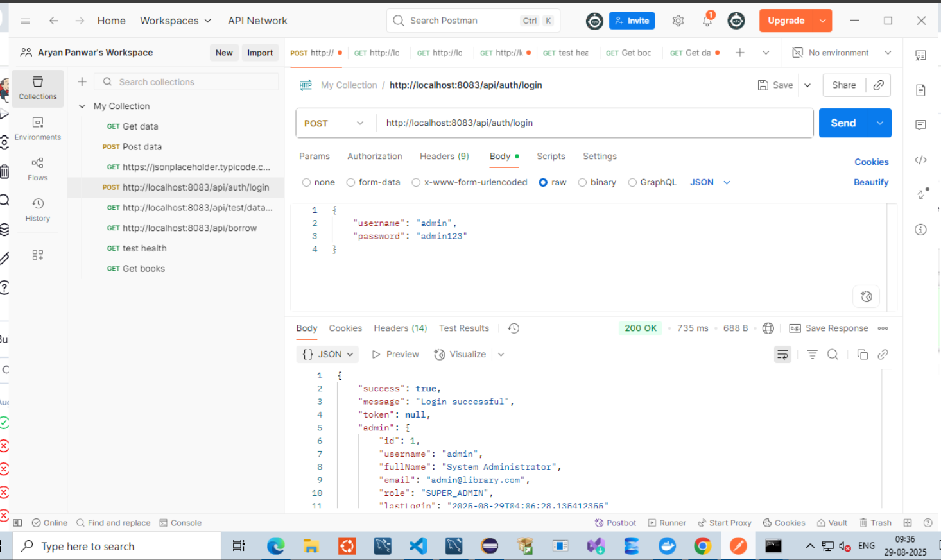
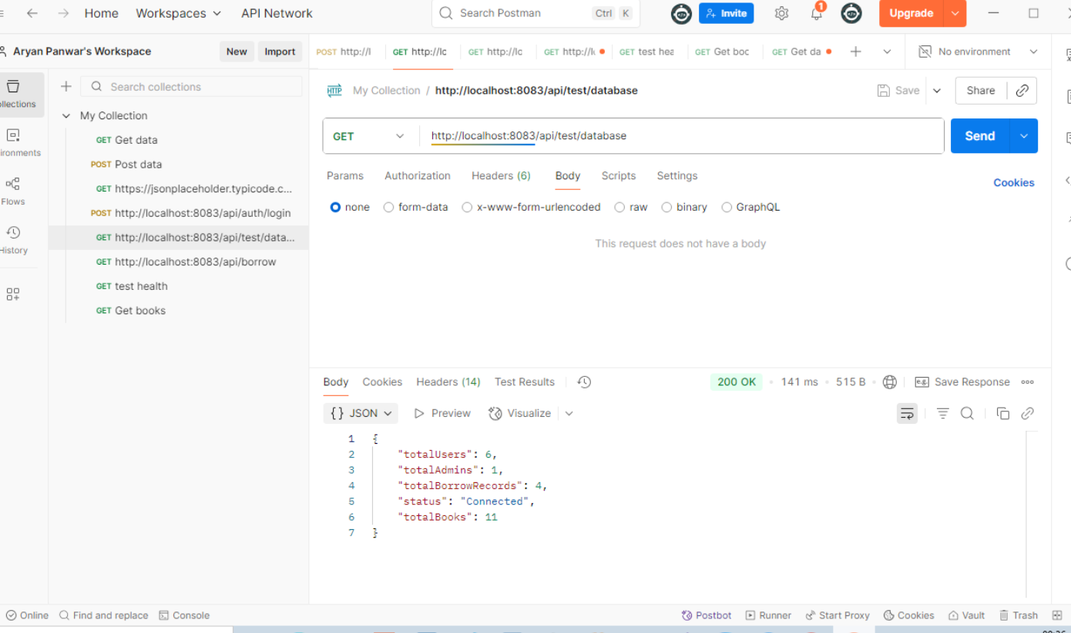
Postman Endpoints Testing
2025 - RPS Consulting all rights reserved

Slide 18
THANK YOU
www.rpsconsulting.in

